Slide 1
IBA-SBS International Conference, 2022
Examining Customer Loyalty among Omni-channel Users in the Age of Disruptions in Retailing
Presented by: Sheeraz Yar Khan (Salim Habib University)
Dr. Jawaid Ahmed Qureshi (SZABIST)

Slide 2
INTRODUCTION
In the context of retail management, omni-channel is a relatively modern phenomenon that provides consumers the choice of onsite and online access to retail channels (de Borba et al. 2020; Hamouda, 2019; Hänninen, Kwan, & Mitronen, 2021; Jocevski et al., 2019; Li et al., 2022; Neslin, 2022; Rodríguez-Torrico et al., 2020; Sahu, Khan, & Gupta, 2021; Sorkun, Hüseyinoğlu, & Börühan, 2020).
The inclusion of online and offline channels has resulted in the expansion of customer touch points. Customers demand the freedom to choose from the available channels during the product purchase process based on their needs and purchase decision phase (Peltola, Vainio, & Nieminen, 2015).
Three dimensions of omni-channel seamless interaction: consistency, freedom in channel selection, and synchronization across channels are found to be significant determinants of this particular construct (Rodríguez-Torrico, Trabold Apadula, San-Martín & San José Cabezudo, 2020).

Slide 3
INTRODUCTION contd.
Retailers and service providers expect that good experience provided to consumers will eventually pave the way to attaining a higher level of satisfaction among customers (Hamouda, 2019; Rodríguez-Torrico et al. 2020).
Satisfying the customer is identified as a significant determinant of generating and maintaining the level of customer loyalty (Hamouda, 2019).

Slide 4
INTRODUCTION contd.
A comprehensive omni-channel strategy requires a much advanced level of logistics approach because the modern consumer prefers an integrated process and a consistent view of the product, irrespective of the channel (Adivar et al., 2019).
It is the advancement of technology as well as increased level of digitalization that has dramatically revamped the retail industry and opened new avenues for a seamless service experience for the modern shopper.

Slide 5
INTRODUCTION contd.
The overall quality of the customer journey through the various stages of the purchase process as well as across numerous touch-points is crucial in impacting customers’ assessments of the service quality provided by the omni-channel retailer (Baxendale et al., 2015).
Today’s customers keep on moving toward an increasingly complex shopping journey by virtue of their engagement with a variety of communication devices, which give them access to a multitude of channels (Mintel, 2014).

Slide 6
RESEARCH PROBLEM
In the context of Pakistani consumers, achieving success in an omni-channel based strategy is deemed highly challenging as satisfying the customer in these competitive times is becoming increasingly difficult.
The general business problem is that retail managers experience loss of revenue because of poorly planned and executed customer experience strategies, which drive customers to other retail establishments (Hamouda, 2019; Rodríguez-Torrico et al. 2020).

Slide 7
RESEARCH PROBLEM contd.
The specific issue is that retail managers lack knowledge of the techniques and skills needed to devise and implement appropriate strategies for building brand loyalty by virtue of improving customer experience.
A limited number of studies focusing on various dimensions of omni-channel’s seamless interaction experience have explored the linkages with customer satisfaction and customer loyalty (Hamouda, 2019; Hänninen, Kwan, & Mitronen, 2021; Jocevski et al., 2019; Rodríguez-Torrico et al., 2020; Sahu, Khan, & Gupta, 2021; Sorkun, Hüseyinoğlu, & Börühan, 2020). In order to bridge this gap, the current research aims to provide a comprehensive model of customer satisfaction and loyalty by assessing the dimensions of customer seamless experience, its influence on customer satisfaction and then predict the level of customer loyalty based on customer satisfaction (Hamouda, 2019; Rodríguez-Torrico et al. 2020).

Slide 8
REVIEW OF LITERATURE
Both the customer and the retailer are engaged in the simultaneous use of channels and devices, starting from information search and concluding at order fulfillment and possible product return (Verhoef et al., 2015).
According to Cao and Li (2015), various benefits accrue to the firm that achieve a high level of cross-channel integration; these include higher levels of customer loyalty, as well as greater sales growth.

Slide 9
REVIEW OF LITERATURE contd.
According to Bacon (2015), the key drivers to success in an omni-channel environment include: empowering the customer in terms of access to consistency in pricing and promotional activities, and harnessing online data analytics to create a holistic profile of the typical customer.
According to Hall and Towers (2017), the total quantum of various touchpoints during the purchase journey has significantly been enhanced as a consequence of the greater variety of channels available for the various stages, which has given the consumer a multitude of options.

Slide 10
REVIEW OF LITERATURE contd.
Lemon and Verhoef (2016) have pointed to the advantage of a seamless experience, which encompasses several touchpoints, in the form of delivering a much more nuanced customer experience.
Traditionally, loyalty intentions have been defined as the customer’s disposition to either continue to repurchase form the existing provider, or possibly shift to a competitor (Klaus and Maklan, 2013).

Slide 11
REVIEW OF LITERATURE contd.
The ultimate goal of attaining customer loyalty in the long-term is a natural outcome of effective designing and management of the overall customer experience, which requires an organization-wide approach and commitment from the various actors responsible for managing the touchpoints (Payne et al., 2017).
Recent research literature mentions an increasing tendency of omni-channel physical stores to blend innovative technological options to create a mixed model in which the interactivity of an online shopping experience is amalgamated with the rich sensorial engagement of a physical store (Alexander and Alvarado, 2017).

Slide 12
REVIEW OF LITERATURE contd.
The modern consumer uses multiple communication devices to gain access to several channels simultaneously and demands connectivity and mobility (Lazaris and Vrechopoulos, 2014).
The literature uses the term ‘channel agnostic’ for such consumers because they are indifferent to the channel and more concerned about the utilitarian objective of getting the right product at the right price (Aubrey and Judge, 2012).

Slide 13
REVIEW OF LITERATURE contd.
The underpinning theories
Arora and Sahney (2018) applied theory of planned behavior (TPB) while investigating consumers’ conduct during webrooming to judge their attitude, subjective norms and behavioral control affecting their intentions and behavior of shopping.
Fu and Juan (2016) integrated TPB with customer satisfaction theory to learn passengers’ behavior. We have also applied TPB and customer satisfaction theory in the context of omni-channels. The broad research question is how omni-channels’ seamless interaction affects customer satisfaction that leads to customer loyalty.

Slide 14
RESEARCH FRAMEWORK Source(s): Adapted from Hamouda (2019); Lee & Kim (2010); Oh & Teo (2010); Rodríguez-Torrico et al., 2020; Walsh et al. (2014); Wu & Chang (2016)

Slide 15
RESEARCH METHODOLOGY
Quantitative method for generalization of results
Cross-sectional survey design
Respondents: Omni-channel users
Convenient sampling
212 participants/samples
SEM through Smart PLS

Slide 16
MEASUREMENT OF VARIABLES
Construct | Items | Scale | Source
Consistency | 5 | Likert-type Scale | Kim (2010) and Wu and Chang (2016)
Freedom in Section | 5 | Likert-type Scale | Lee and Kim (2010)
Synchronization | 5 | Likert-type Scale | Oh and Teo (2010)
Satisfaction with Omni-interaction | 5 | Likert-type Scale | Walsh et al. (2014)
Customer Loyalty | 5 | Likert Scale | Hamouda (2019)

Slide 17
SAMPLE SIZE
Rule of thumb: At least five-fold in comparison with the number of parameters (Bentler and Chou, 1987)
Sample size to parameter ratio of 4:1 (Tanaka, 1987)
Total number of samples: 212

Slide 18
RELIABILITY TEST
If the coefficient value is under 0.6, it generally points to a level of internal consistency reliability that is considered less than satisfactory (Malhotra, 2008).
According to Nunnally & Bernstein (1994), the range of 0.7 to 0.8 is deemed an acceptable range for reliability estimates, especially in research falling within the realm of social sciences.
According to Byrne and Van De Vijver (2010), the convergent validity of the construct comes under question in case the AVE value is less than 0.5, which is indicative of the fact that the variance of measurement error is higher than that of the construct.

Slide 19
DATA ANALYSIS TECHNIQUES
Stage 1 – Data screening and data preparation; test of normality; outlier treatment, using the SPSS software
Stage 2 – Assessment of reliability, convergent validity, and discriminant validity
Use of Structural Equation Modeling (SEM)
The SmartPLS software was used in this study because of its ability to employ a confirmatory approach of a structural theory that produces observations on several variables (Byrne, 2016).

Slide 20
ASSESSMENT OF MEASUREMENT MODEL
Fornell and Larcker (1981) criterion
If AVE (average variance extracted) is 0.5 or above, the constructs are believed to have acceptable construct validity.
The structural model was estimated by running the PLS-SEM algorithm.

Slide 21
ASSESSMENT OF MEASUREMENT MODEL
The resultant value of CV (convergent validity) ensures that all the items of measurement represent the same underlying construct.
The loadings of the indicators should be above 0.6 as per the criterion suggested by Chin, Gopal, and Salisbury (1997) and Gholami, Sulaiman, Ramayah and Molla (2013).
In addition, the value of AVE should be above 0.5, and CR should be above 0.7.

Slide 22
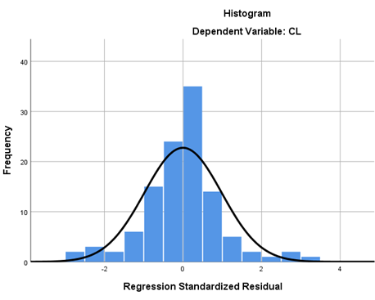
DATA ANALYSIS AND FINDINGS
Preliminary Analysis
Missing Values Analysis
Outliers Assessment (12 outliers were found)
Data Normality Assessment
Multicollinearity Analysis
 |  | Collinearity Statistics
 |  | Tolerance | VIF
 | SOI | .666 | 1.501
 | Syn | .543 | 1.842
 | C | .430 | 2.325
 | FiS | .439 | 2.275

Slide 23
DATA ANALYSIS AND FINDINGS
Latent Constructs and Items Loadings AVE CR
Consistency
C1 0.792
C2 0.854 0.671 0.891
C3 0.829
C5 0.801
Customer Loyalty
CL1 0.914
CL2 0.964
CL3 0.964 0.858 0.968
CL4 0.850
CL5 0.933
Freedom in Selection
FiS1 0.727
FiS3 0.773 0.646 0.845
FiS4 0.901
Satisfaction with Omni-interaction
SOI1 0.917
SOI2 0.927
SOI3 0.880 0.816 0.957
SOI4 0.889
SOI5 0.902
Synchronization
Syn1 0.757
Syn2 0.709
Syn3 0.870 0.622 0.908
Syn4 0.785
Syn5 0.821
Syn6 0.780
Loadings, Composite Reliability and Average Variance Extracted

Slide 24
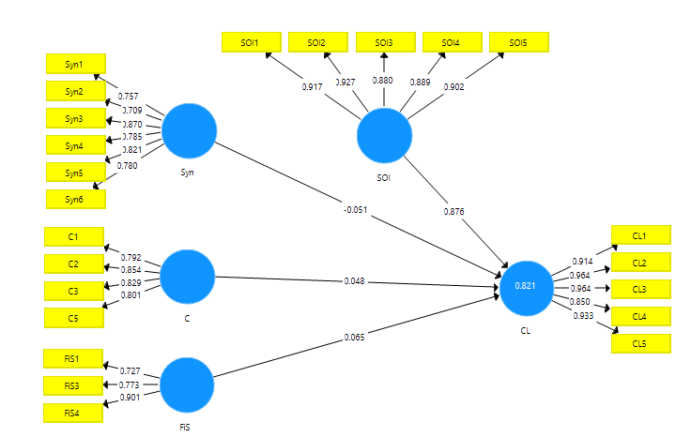
DATA ANALYSIS AND FINDINGS

Slide 25
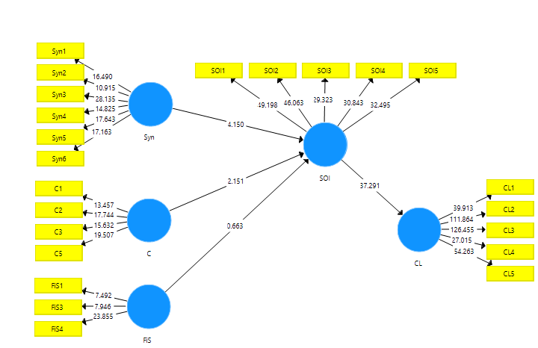
DATA ANALYSIS AND FINDINGS
Structural model
CL= Customer Loyalty, SOI= Satisfaction with Omni-interaction, Syn= Synchronization, C= Consistency, FiS= Freedom in Selection

Slide 26
DATA ANALYSIS AND FINDINGS
No. | Relationship | Beta |  | T | p | Decision
H1 | Consistency has a significant influence on Satisfaction with omni-channel. | 0.259 |  | 2.151 | 0.031 | Supported
H2 | Freedom in selection has a significant influence on satisfaction with omni-channel. | 0.078 |  | 0.663 | 0.507 | Not Supported
H3 | Synchronization has a significant influence on satisfaction with omni-channel. | 0.354 |  | 4.150 | 0.000 | Supported
H4 | Satisfaction with omni-interaction has a significant influence on customer loyalty. | 0.901 |  | 37.291 | 0.000 | Supported

Slide 27
DATA ANALYSIS AND FINDINGS
No. | Relationship | Beta |  | T | p | Decision
H5 | Satisfaction with omni-interaction mediates the relationship between consistency and customer loyalty. | 0.233 |  | 2.147 | 0.032 | Supported
H6 | Satisfaction with omni-interaction mediates the relationship between freedom in selection and customer loyalty. | 0.070 |  | 0.663 | 0.507 | Not Supported
H7 | Satisfaction with omni-interaction mediates the relationship between synchronization and customer loyalty. | 0.319 |  | 4.093 | 0.000 | Supported

Slide 28
Research Contributions
Practical Implication
These results on the dynamics of service quality provide guidelines to managers on how to create a blueprint of an effective multichannel system beneficial for both customers and companies.
These findings highlight the key determinants of omni-channel experience which significantly impact customers’ behavioral beliefs and intention in omni-channel shopping.
This research has a significant contribution to existing knowledge on service quality, omni-channel management, and multichannel service quality research.
This study expands the literature in the fields of consumer behavior in omni-channel by taking into account constructs such as consistency, freedom in selection, synchronization, satisfaction and customer loyalty.
Our model adapts its variables from six different but pertinent studies and employs underpinning theories of planned behavior (for variables including consistency, freedom in selection and synchronization) and customer satisfaction.
Theoretical Contributions

Slide 29
THANK YOU SO MUCH
FOR LISTENING

