Slide 1
Effect of Influencer Message Value on Destination Awareness, Image and Travel Intentions
Presented by Shumaila Kashif

Slide 2
Background
Global travel and tourism market is expected to reach US$:1,014 billion by 2026 with CAGR of 12.09% (Statista, 2022).
Pakistan travel account turned negative in 2005 (Baloch, 2007) and took another dip in 2016 (1.3%) (Knoema, 2019).
Contribution of travel and tourism to GDP (% of GDP) climb by 2.38 % in 2019.

Slide 3
Background
Various bloggers and travel influencers visiting Pakistan. Their experience is creating favorable perception.
Tourism and travel services cannot be pretested before purchase and therefore decision making becomes complex.
This study combines advertising value model of Ducoffe (1995, 1996) and source characteristics “to examine how influencer’s message value and characteristics impact destination awareness, image and travel intentions.

Slide 4
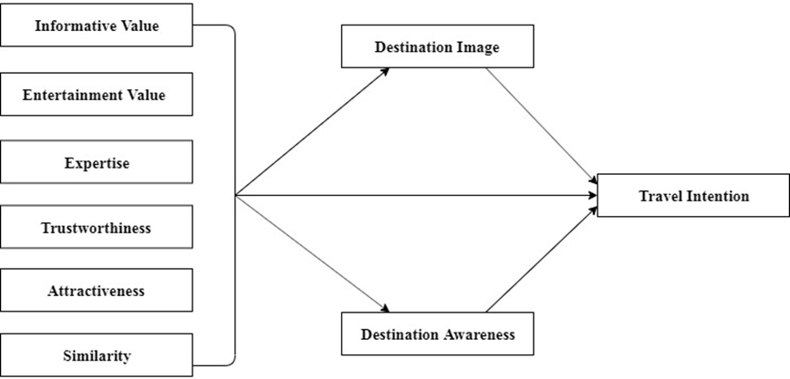
Conceptual Framework

Slide 5
Literature Review
Advertising value is a useful measurement criterion for evaluating advertising effects generally, and particularly in the case of the Web (Ducoffe, 1995, 1996, 2000).
Ong & Ito (2019) discussed the role of social media influencers (SMI) as opinion leaders effectively change destination image and travel intentions.
Lou & Yuan (2019) showed that trustworthiness, content, similarity and attractiveness of the influencer have positive impact on the trust of followers that affect brand awareness and intention.

Slide 6
Methodology
Data from 216 respondents was collected during Nov & Dec 2020 through purposive sampling via google forms.
Two recruiting questions.
38%, 22%, 28% and 11% of the respondents have been following (reading or watching) travel influencer blog for less than 6 months, a year, more than a year and more than two years respectively.
MS Vlog (17%) is most favorite influencer, followed by Eva Zu Beck and Sham Idress (11%) and others (Fun for Lious, Maheen, Aamir Atta, Mehran Hashmi, JA Kara, Zaid Ali, Casey Nistat) 5.6% each.

Slide 7
Variables | No. of Items | Adopted Source(s)
Information | 4 | (Overby & Lee, 2006)
Entertainment | 4 | (Overby & Lee, 2006)
Trustworthiness | 4 | (Munnukka et al., 2016)
Expertise | 4 | (Munnukka et al., 2016)
Similarity | 3 | (Munnukka et al., 2016)
Attractiveness | 4 | (Munnukka et al., 2016)
Destination Image | 5 | (Chen & Tsai, 2007)
Destination Awareness | 3 | (Lai & Vinh, 2013)
Travel Intention | 3 | (Mohammed Abubakar, 2016)

Slide 8
Profiling of Respondents
61% male, 39% female
83% (single), 17% (married)
Age : 21-30 (89%), below 21 (11%)
Graduate (50%), Post-grade (28%), under grads (22%)

Slide 9
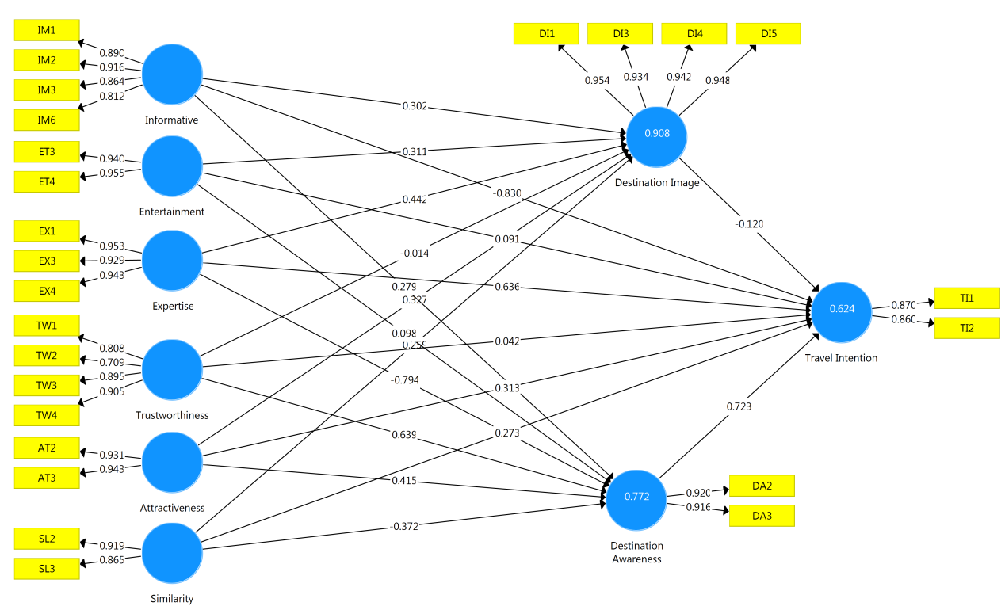
Measurement Model Assessment

Slide 10
Convergent Validity
 | Composite Reliability | Average Variance Extracted (AVE)
Attractiveness | 0.935 | 0.878
Destination Awareness | 0.914 | 0.842
Destination Image | 0.971 | 0.892
Entertainment | 0.946 | 0.897
Expertise | 0.959 | 0.886
Information | 0.927 | 0.760
Similarity | 0.887 | 0.797
Travel Intention | 0.856 | 0.748
Trustworthiness | 0.900 | 0.694

Slide 11

Structural Model Assessment

Slide 12
Summary of Results
Destination image to travel intention, Expertise to destination awareness were insignificant.
Trustworthiness was also insignificant to destination image and travel intentions.

Slide 13
Implications
Influencer expertise and similarity is critical when considering travel influencer for promotion of destinations as it can negatively affect the awareness.
Information and trustworthiness is another important factor for bringing higher level of awareness among the people.
Expertise and similarity were negative as people are likely to perceive Pakistan being similar in every region or similar to India, that is a tourism giant, which decreases their perception of Pakistan as a different country overall.

Slide 14
References
Almeida, M.N.d. (2019). Influencer marketing on instagram: How influencer type and perceived risk impact choices in the beauty industry.
Baloch, Q.B. (2007). Managing tourism in pakistan: A case study of chitral valley. Journal of Managerial Sciences, 2(2), 169-190.
Chen, C.-F., & Tsai, D. (2007). How destination image and evaluative factors affect behavioral intentions? Tourism management, 28(4), 1115-1122.
Chi, H.-K., Huang, K.-C., & Nguyen, H.M. (2019). Elements of destination brand equity and destination familiarity regarding travel intention. Journal of Retailing and Consumer Services.
De Noni, I., Orsi, L., & Zanderighi, L. (2019). Stereotypical versus experiential destination branding: The case of milan city. City, Culture and Society, 17, 38-45.
Ghaderi, Z., Hatamifar, P., & Henderson, J.C. (2018). Destination selection by smart tourists: The case of isfahan, iran. Asia Pacific Journal of Tourism Research, 23(4), 385-394.
Ketelaar, P.E., Willemsen, L.M., Sleven, L., & Kerkhof, P. (2015). The good, the bad, and the expert: How consumer expertise affects review valence effects on purchase intentions in online product reviews. Journal of Computer-Mediated Communication, 20(6), 649-666.
Lai, W.-H., & Vinh, N.Q. (2013). Online promotion and its influence on destination awareness and loyalty in the tourism industry. Advances in Management and Applied Economics, 3(3), 15.
Ling, G.M., Huat, T.S., Fern, Y.S., & Boon, L.K. Purchase intention of consumers from melaka towards mobile advertising.
Lou, C., & Yuan, S. (2019). Influencer marketing: How message value and credibility affect consumer trust of branded content on social media. Journal of Interactive Advertising, 19(1), 58-73.

Slide 15
Thank you!

